Slide 1
MENTAL HEALTH
Understanding Mental Illness

Slide 2
Defining Mental Illness
Clinical definition
Clinically significant behavioral problems
Associated with distress (painful symptoms)
Causes disability (impairment in functioning)
A biological illness that responds to treatment
Not to be confused with weakness of character

Slide 3
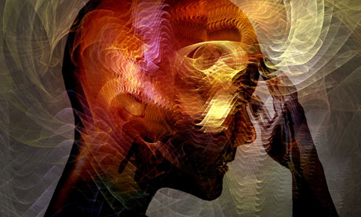
Facts about Mental Illness
Has nothing to do with intelligence
Can happen to anyone
Chronic but not contagious
Difficult to diagnose and to treat
Treated but not cured
Mentally ill are not all dangerous
Should not be confused with terms psychopath or sociopath

Slide 4
General Signs of Mental Illness
Observable
Confusion
Disoriented
Darting looks
Talking to self
Poverty of Speech
Pressured speech
Poor hygiene
Inappropriate attire
Behavior Changes
Flat Affect
Withdrawn
Sad or anxious mood
Panic
Psycho somatic complaints

Slide 5
Schizophrenia
Symptoms
Brain disease
Includes psychosis
Impacts 1 out of every 100 people.
Does not differentiate across SES
Onset is late teens, early adulthood.
May appear non compliant
Agitated by voices and delusions -may look and act dangerous
Command hallucinations may actually be dangerous
More likely to respond to clear directions, and reassurance in a kind tone of voice
Poor hygiene - Not aware of their surroundings enough to know that they are not clean
Positive Symptoms include :
  hallucinations
  delusional thinking
Negative symptoms include
  apathy
  withdrawal.

Slide 6
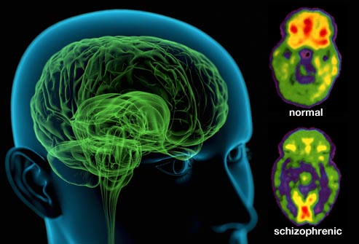

Slide 7
Depression
Symptoms
Affects 5 percent of the general population
Sad mood that lasts 2 weeks
Loss of interest or pleasure in daily activities
Changes in sleep, appetite, decreased energy
Thought problems affect concentration, memory, decisions, feelings of guilt, worthlessness
Risk of suicide is high
Important to differentiate mental health from physical problems
Responds well to treatment
Loss of interest in food and self care
Risk of suicide may increase after medication

Slide 8
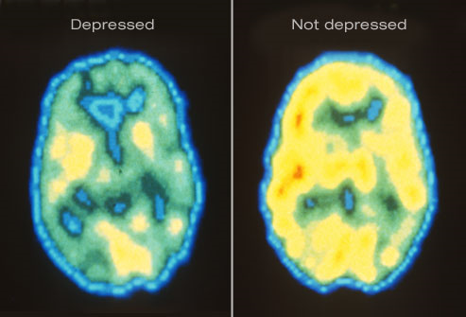

Slide 9
Mania/Bipolar Disorder
Symptoms
Euphoric mood (elevated, high or happy)
Irritable mood (touchy)
Three Stages of Mania
Hypomania, Acute Mania, Psychosis
Mood swings from depression to mania
Can be Rapid Cycling
Mood can swing from entertaining to hostile
Talkativeness can be irritating
If depressed, often cry, feel hopeless, become suicidal
Can be restless, pacing, demanding and destructive
12
Often non-compliant
Can be professional and well-educated

Slide 10
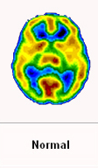
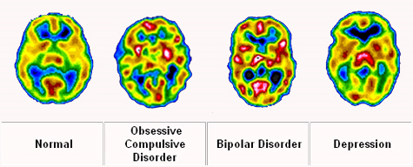

Slide 11
Panic Disorders
Symptoms
Prevalence is 1 to 2 percent of the population; Women twice as high as men.
Panic attacks occur without warning
Symptoms include intense fear, heart palpitations, chest pain, shortness of breath, dizziness
Person is concerned that the attacks will strike again

Slide 12
Obsessive Compulsive Disorder
Symptoms
Obsessions are recurrent thoughts, images, impulses that cause anxiety. They are illogical, at times repulsive and/or center on violence or harm.
Compulsions are behaviors that are repetitive - attempts at reducing the anxiety created by the obsessions.

Slide 13
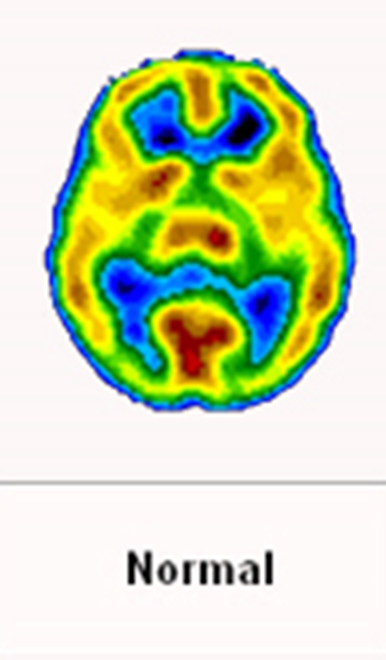

Slide 14
Post Traumatic Stress
Symptoms
Exposure to an extremely stressful event.
Painful memories, nightmares,, suspicion, anxiety, depression, feelings of guilt and sleep difficulties
Symptoms worsen with exposure to similar events
Substance abuse is a common method to cope

Slide 15
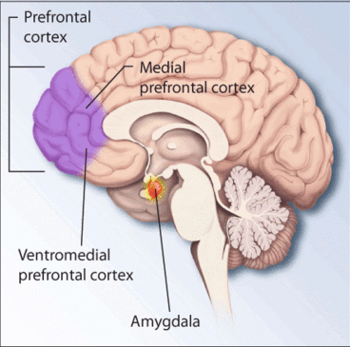

Slide 16

Personality Disorders
Inflexible, maladaptive, ways of coping and relating
Difficulty in holding steady work and relationships
Difficult to change
Can co -exist with other mental illnesses

Slide 17
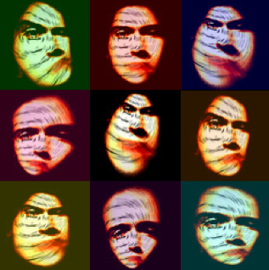
Types of Personality Disorders
Antisocial
Narcissistic
Borderline
Avoidant
Paranoid
Dependent
Schizotypal
Schizoid

Slide 18
Co-occurring Disorders
Presence of both a mental illness and substance abuse disorder
High prevalence rates
60% of persons with a mood disorder also have a substance abuse disorder
50% of persons with schizophrenia also have a substance abuse disorder

Slide 19
Common Factors of Mental Illness and Substance Abuse
Brain disorders
Lack of Insight
Chronic
Impacts Family
Shame and guilt
Needs Treatment

Slide 20
Dementia and other Cognitive Disorders
Symptoms
Memory problems
Confabulations
Impaired thinking
Impaired Judgment
Poor memory and may not follow directions
Treat individual as you would any with a disability

